Slide 1
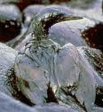
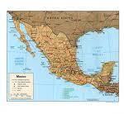
Dilemma Story Pedagogy for Sustainability Education
Workshop 1Session 1

Slide 2
Setting the scene...
Oil Spill in the Gulf of Mexico
http://www.youtube.com/watch?v=8LzIoi5GGko&feature=related
http://www.youtube.com/watch?v=68bKMtncSuw&feature=related
http://www.youtube.com/watch?v=77pBcf0o444&feature=related
Question – was the damage worth saving $500 000?

Slide 3
Enter...Craig Venter
http://www.youtube.com/watch?v=vOPkECdzTY0&feature=related
...replaced the natural genome in a cell with a slightly modified synthetic genome which issued orders by which the cell reproduced

Slide 4
Questions arising...
Given the catastrophic extent of the oil spill in the Gulf of Mexico...
...why don’t we create organisms in the lab that ‘love’ to eat oil spills?
...why don’t we create algae that produce cheap biofuel?
...why don’t we create bacteria that specialise in cancer cells to eliminate tumors from human bodies?

Slide 5
Risks involved
Thomas Murray (President of the Hastings Centre for Bioethics): “When dealing with biological entities life has a tendency to find a way!”

Slide 6
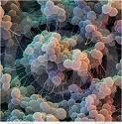
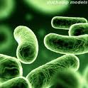
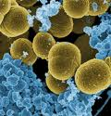
What if...
...there is an accident at a bio power plant?
...we don’t know how the mutated algae will react in a natural environment
...the oil-eating organism ‘learns’ to prefer ‘oil’ in living fish species to crude oil?
...the tumor-fighting bacteria create new diseases?
...

Slide 7
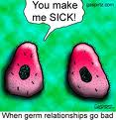
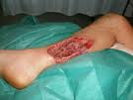
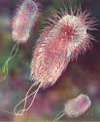
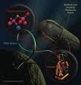
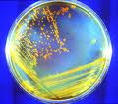

Slide 8
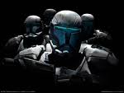
How do YOU feel about...
...cloned children
...human-animal hybrids
...a fetus grown solely to harvest its parts
...a fetus grown using our own genome to serve as the perfect spare parts supply
...the statement: “ Craig Venter did not invent life in any sense of the word, other than somebody who types on a computer has invented the computer.”

Slide 9
Ethical dilemmas...
somebody (often politicians) has to make decisions whether or not knowledge created through scientific research can and should be used
ethical dilemmas force decision-making on matters that can potentially harm living beings, environments, ...others.

Slide 10
Why is ethical decision-making important?
human beings do not live in isolation
part of the great web of life and the universe
all decisions that are made somewhere affect everybody in one way or another
we all make many decisions each day
some decisions of ours are ethical decisions

Slide 11
Ethical dilemmas and sustainability...
climate change and sustainability force us to make many ethical decisions about
use of resources
protection of the natural environment
how we treat other living beings
what we eat
how we dress
what cosmetics to use
how, why, where and when we spend our money
how we treat not only bio-diversity but also cultural diversity
etc.....

Slide 12
Students as decision-makers of the future ...
will inherit our problems
must think of solutions for problems many of which they did not help create
must be able to make ethical decisions based on moral values that appreciate the connectedness between all beings and things

Slide 13
One way of teaching ethical decision-making is through...
story telling:
all great teachers of the world religions have used stories as a means to get ‘deep’ meaning across
meaning too difficult to grasp entirely through the intellect
stories use informal language, imagination and affective messages
Notes:
T

Slide 14
Ethical dilemma stories
tool used in values- and moral education
we view sustainability as a human value
as an area requiring many ethical decisions by individuals and by nations

Slide 15
Ethical dilemma stories
are a type of stories that contain ethical dilemmas
involve students in ethical decision-making
challenge students’ taken-for-granted’ assumptions
get them to think critically & to reflect critically
bring ‘real-life’ into the classroom
can be used in a variety of contexts and learning areas
with adults and children from about Grade 5

Slide 16
Plan for Today
history and philosophy of dilemma story pedagogy
Session 2: examples of dilemma stories
Session 3: characteristics of a dilemma story
student learning with dilemma stories
brainstorming potential topics

Slide 17
History & Philosophy
dilemma stories first used in educational research by Lawrence Kohlberg
developed Stage Theory of Moral Development
he worked exclusively with male students
his model is focused around issues of justice and fairness
Ethics of Fairness/Ethics of Justice

