Slide 1
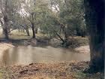
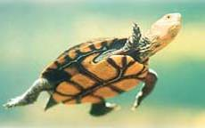
Dilemma Story Pedagogy for Sustainability Education
Workshop 1 - Session 2

Slide 3
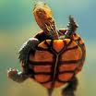
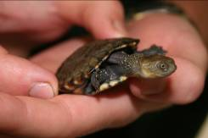
The Western Swamp Tortoise

Slide 4
Western Swamp Tortoise (WST)
has a limited range of places where it lives – 2 swamps in Ellenbrook in Western Australia.
it only produces between 1 to 5 eggs per year and takes 8 to 15 years to reach breeding age.
some of the present population of tortoises are 70+ years old.

Slide 5
It aestivates over summer in hollow logs and under leaf-litter and so is very susceptible to bushfire threats.

Slide 6
Threats
Ellenbrook is an area with fast urban development
the tiny swamps are threatened through diversion of surface water into private dams
fast growing housing estates

Slide 7
Question 1
Should you set an example to neighbours and un-block the stream to allow it to flow and soak away as it did before your family bought the property?
Think about your decision on your own.
Record it together with your reasons.
Compare & discuss your decision with another person

Slide 8
An endangered species
Although 400 hundred more tortoises have been produced through the captive breeding program...
they are from only a small group of parents (only 9 males were found in 1952) and so are...
WSTs are developing a restricted gene pool.

Slide 9
Question 2
Do you think it is a good idea to have WSTs as pets or should the tortoise remain as a rare native animal in its own habitat?
Think about your decision on your own.
Record it together with your reasons.
Compare & discuss your decision and reasons in groups of three.

Slide 10
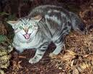
Additional threats
pets (cats and dogs)
feral cats
foxes

Slide 11
Question 3
Should you vote to allow poison (1080) baiting and risk your own pets
or should you vote against poison baiting and allow predators to continue hunting in the area?
Think about your decision on your own.
Record it together with your reasons.
Compare & discuss your decision and reasons in groups of four.

Slide 12
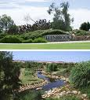
A housing developer wishes to...
buy and develop the swampland habitats that provide refuge to the last remaining WSTs
he argues as follows:

Slide 13
If the WST really is such an endangered animal and basically ‘doomed’ - we are wasting our time, money and energy by protecting this vulnerable animal.
We should instead accept that this fate is a form of natural selection:
‘the fittest’ will survive and the weaker species are just not meant to...
climate change may be part of the earths long term changes and so the tortoise habitat may be doomed to dry out no matter what humans do.

Slide 14
Question 4
What do you decide – should the developer be allowed to buy the swamp land?
First, decide for yourself.
Record your decision together with your reasons.
Then compare & discuss your decision and reasons in groups of four.
Prepare a poster with your group’s opinions
Present to the whole class

Slide 15
A student’s documentary on the WST
http://www.youtube.com/watch?v=L6dXFNot4HA

