Slide 1
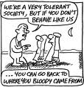
Dilemma Story Pedagogy for Sustainability Education
Dilemma Story Workshop – Session 3

Slide 2
Two problems for aspiring ‘ethics’ teachers
Competency
Insecurity about their knowledge, attitudes, skills and experience (Mehlinger, 1986)
Curriculum materials
Lack of materials in the local language
Lack of time and resources
Notes:
Teacher require knowledge, attitudes, skills and experience (Mehlinger, 1986): the task of teacher education has not been addressed adequately in any UNESCO member state.
Teachers lack time to prepare their own materials

Slide 3
Several research grants and projects
Website:
www.dilemmas.net.au
Materials
Presentations
Dilemma stories written and trialled by teachers
Information on dilemmas stories
Curriculum links

Slide 4
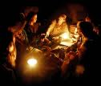
Characteristics of dilemma stories
Storytelling
Interrupted by questions when the story arrives at an ethical dilemma situation
Phases of individual and collaborative reflection
First few questions...warm-up questions..easy..not too deep!
Questions increasingly complex and more challenging

Slide 5
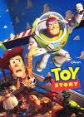
Writing your own dilemma story?
Brainstorm topics for own story

Slide 6
Homework
Write own dilemma story
Where and how does your story fit in the curriculum or in your context?
Microteach own dilemma story
Improve story

Slide 7
If you think this is hard and you can’t do it watch this!
http://www.youtube.com/watch?v=H8ZuKF3dxCY&feature=related

